Slide 1
C/m tam giac dong dang truong hop 2

Slide 2
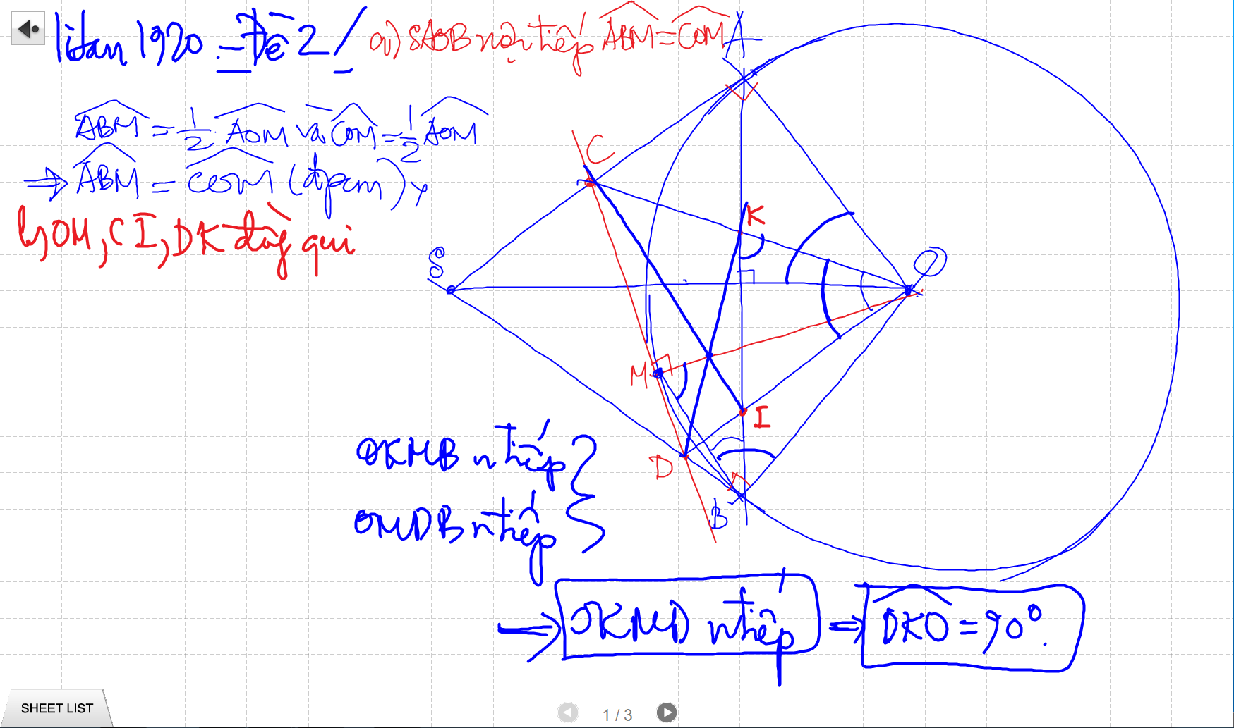
C/m tam giac dong dang truong hop 2

Slide 3
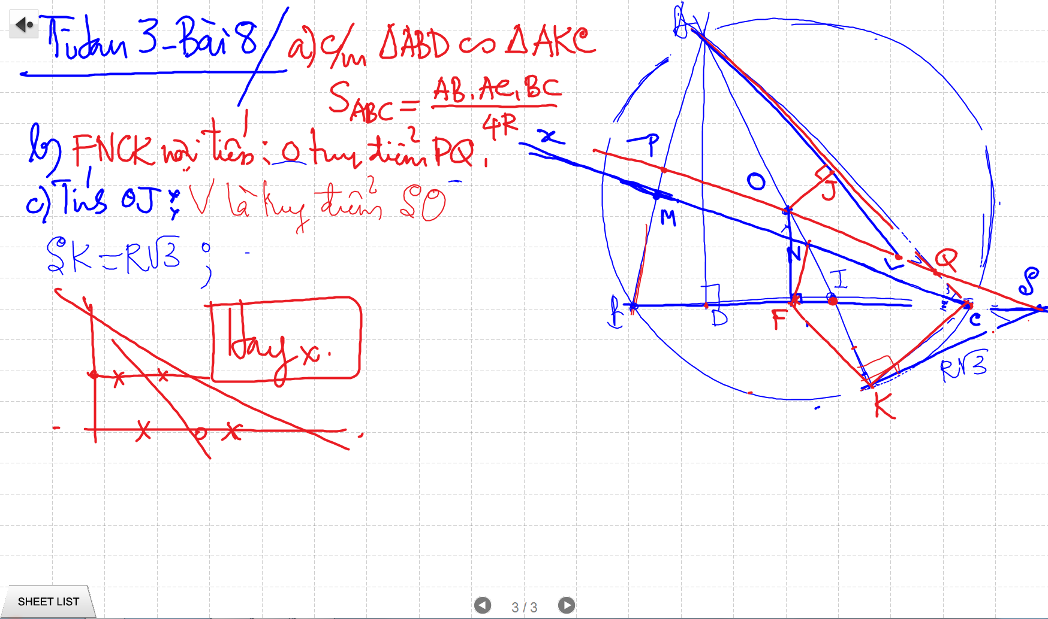
C/m tam giac dong dang truong hop 2

Slide 4
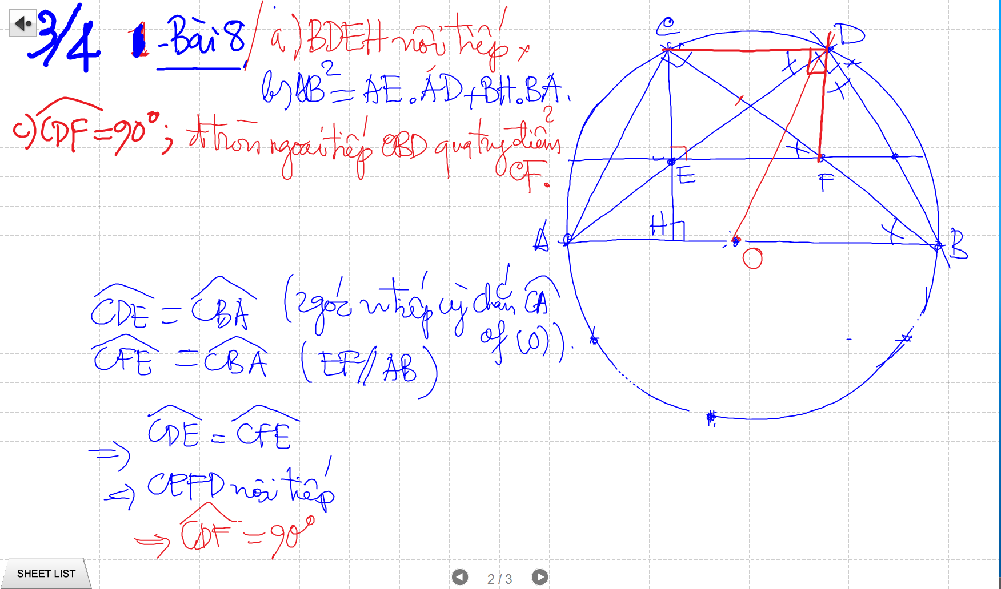
C/m tam giac dong dang truong hop 2

Slide 5
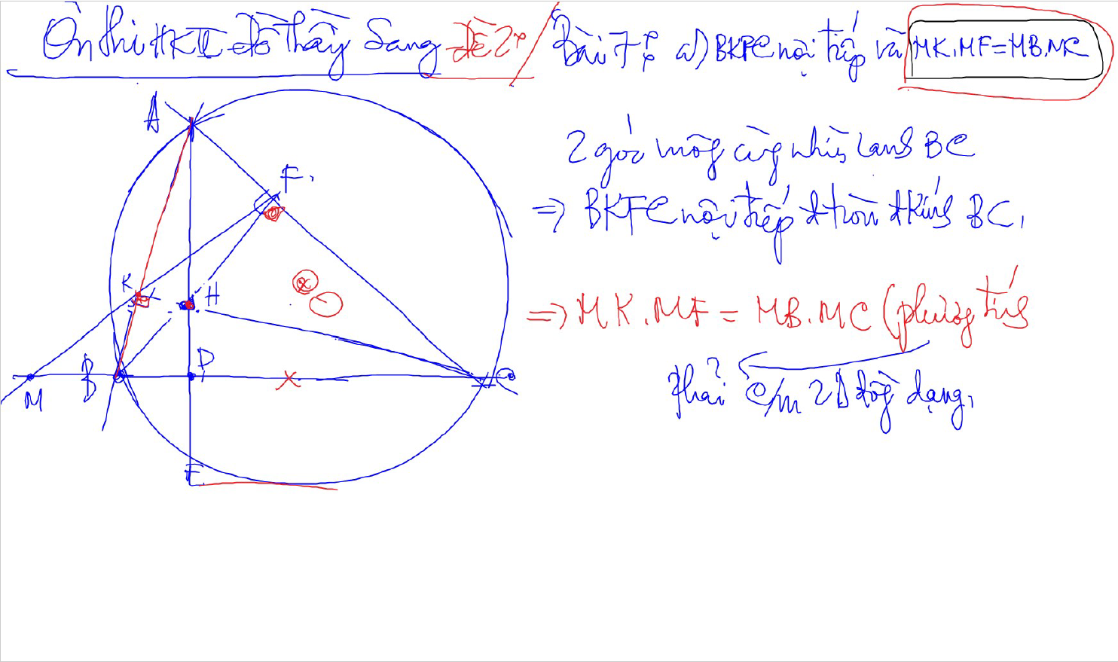
C/m tam giac dong dang truong hop 2

Slide 6
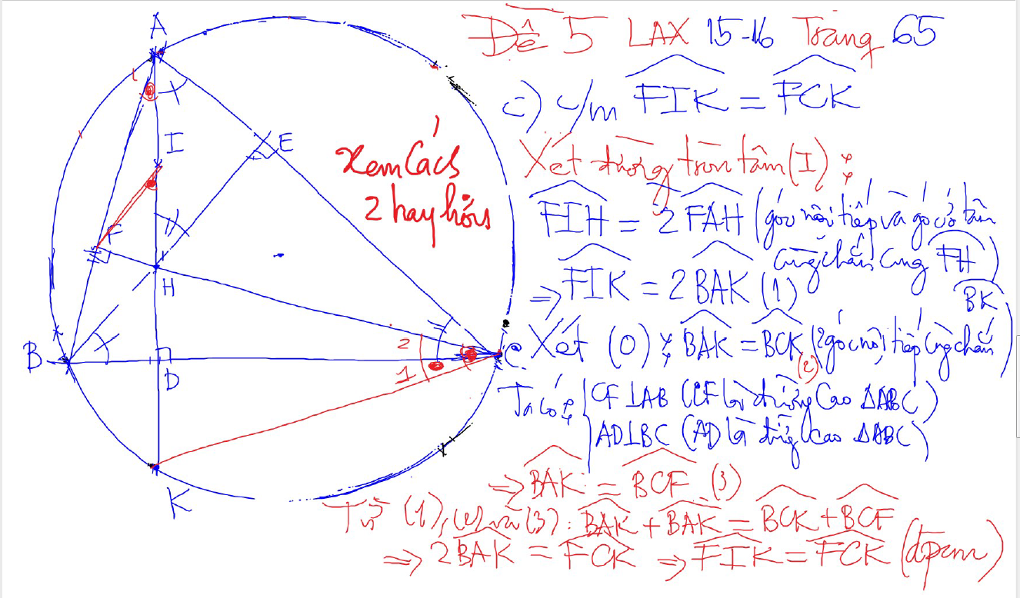
DUONG THANG SIMSON – Ap Dung

Slide 7
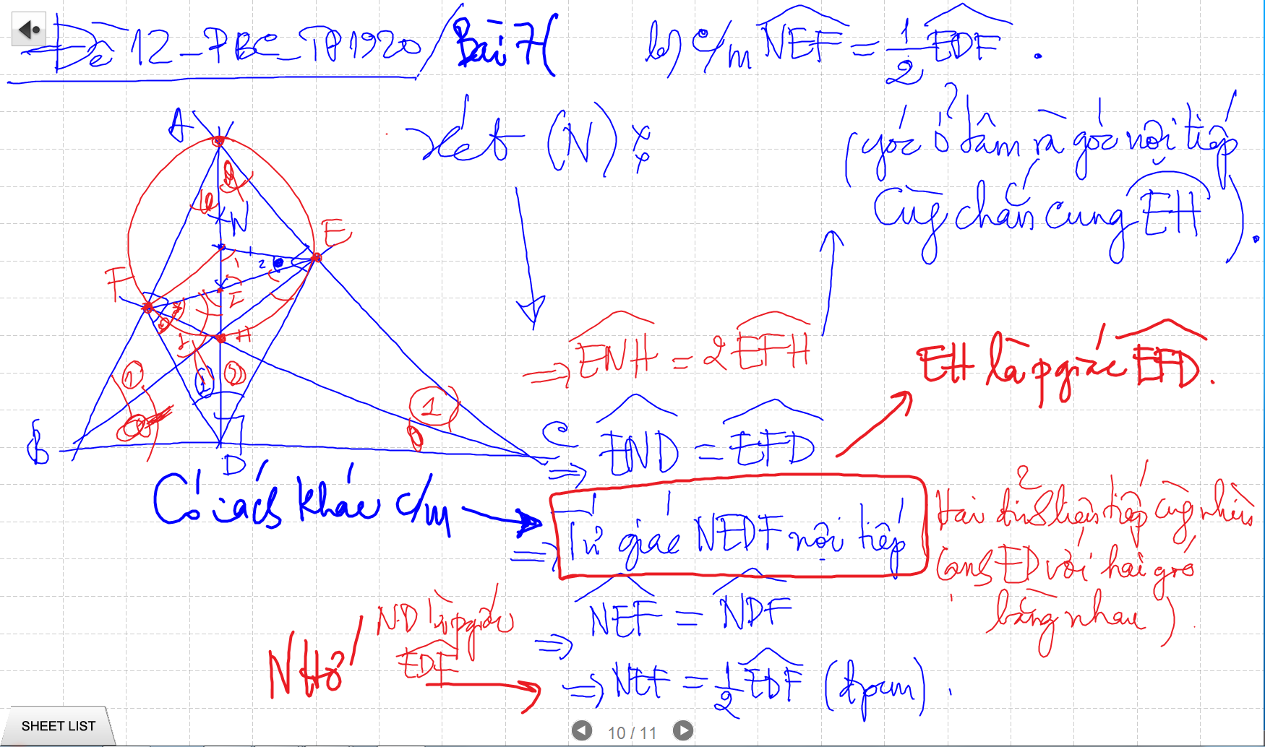
CM TU GIAC NOI TIEP -> SUY RA CAC GOC BANG NHAU

Slide 8
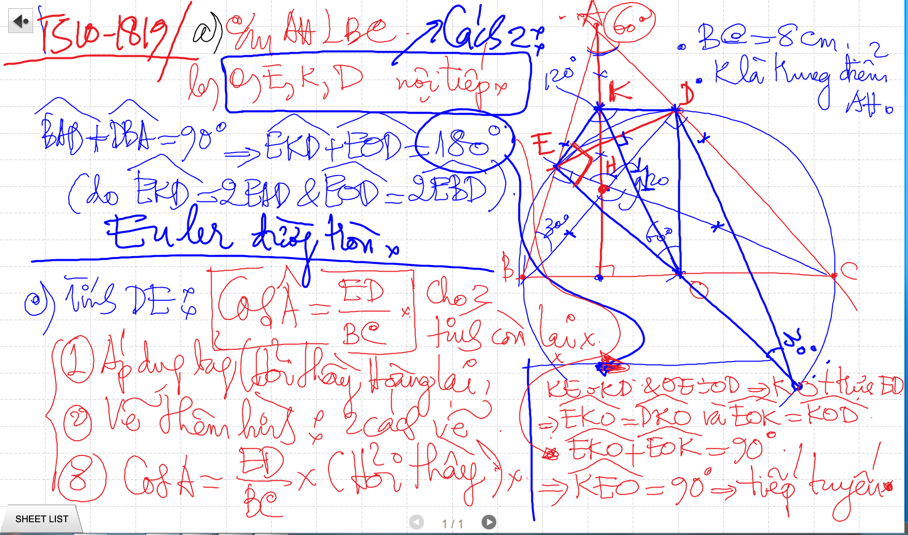
Bai 53 De Cuong – Euler

Slide 9
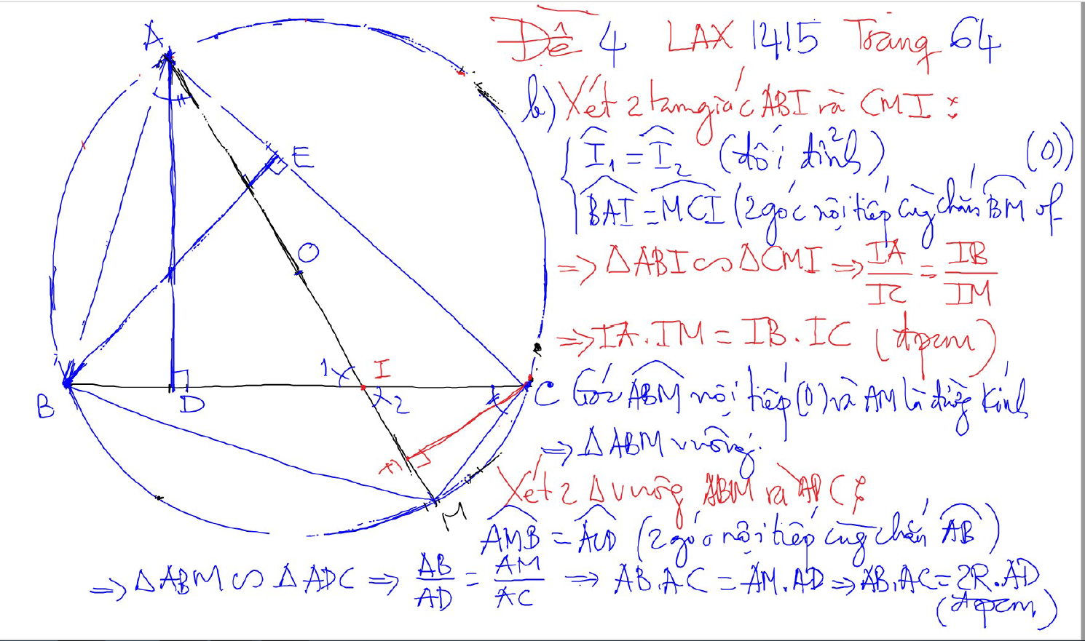
PHUONG TICH DIEM TRONG DUONG TRON

Slide 10
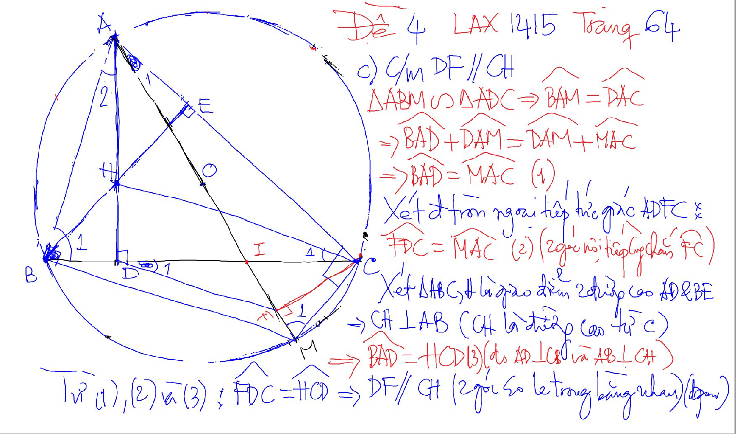
PHUONG TICH DIEM TRONG DUONG TRON

Slide 11
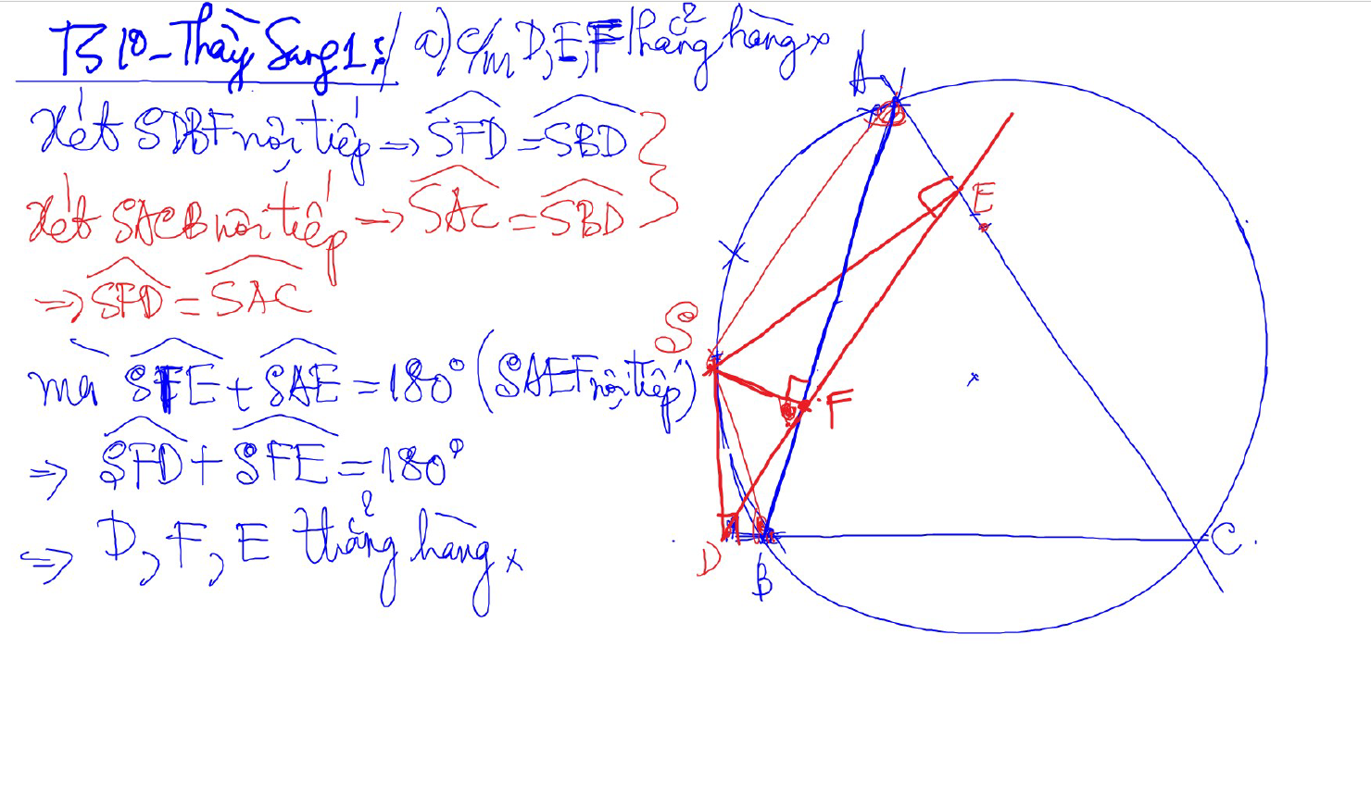
Đường thẳng SIMSON

Slide 12
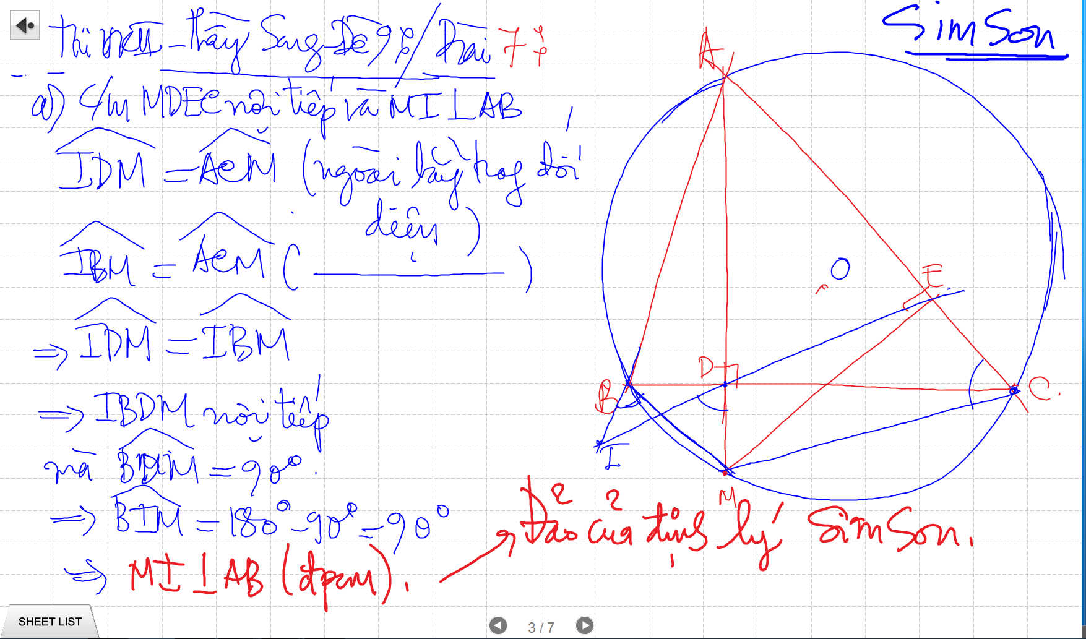
SIMSON

Slide 13
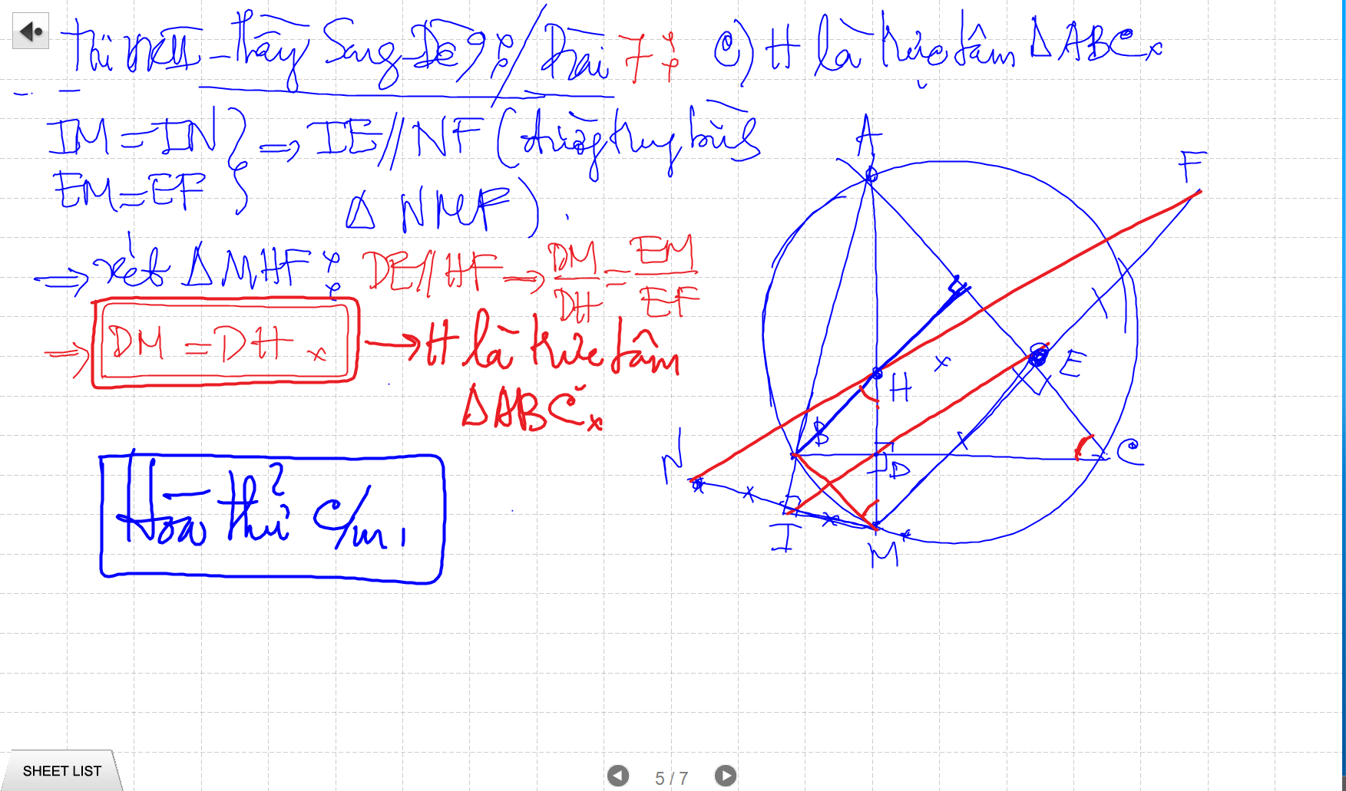
SIMSON

Slide 14
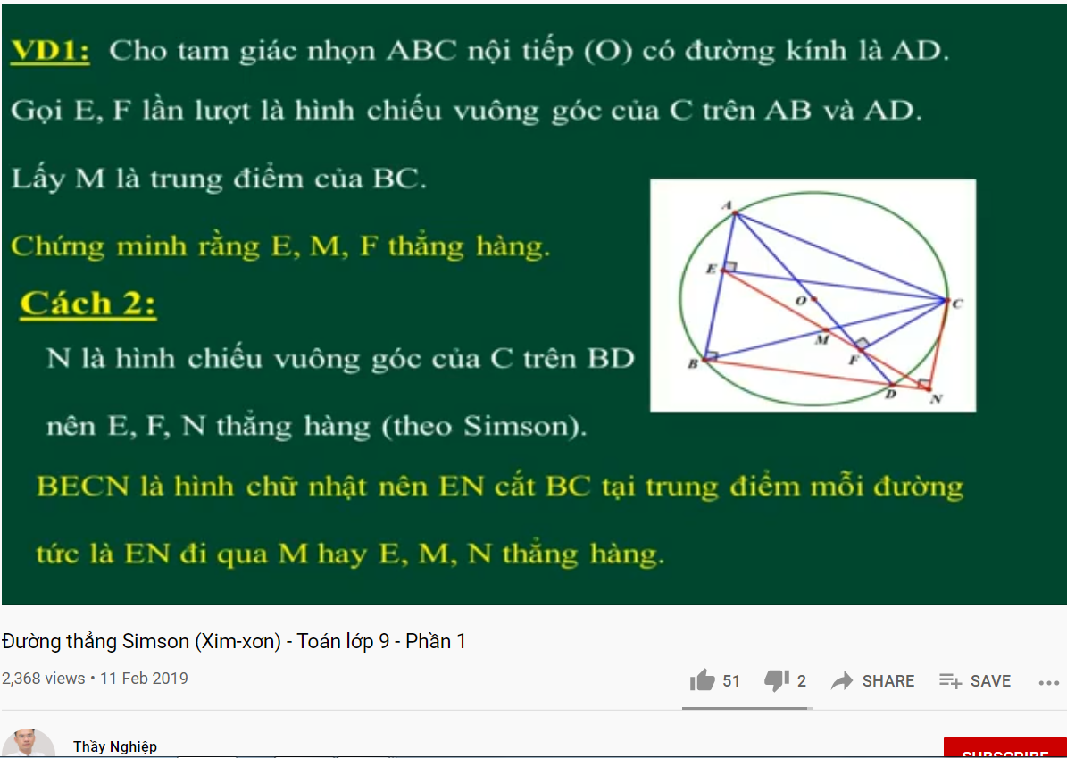
DUONG THANG SIMSON – Ap Dung

Slide 15
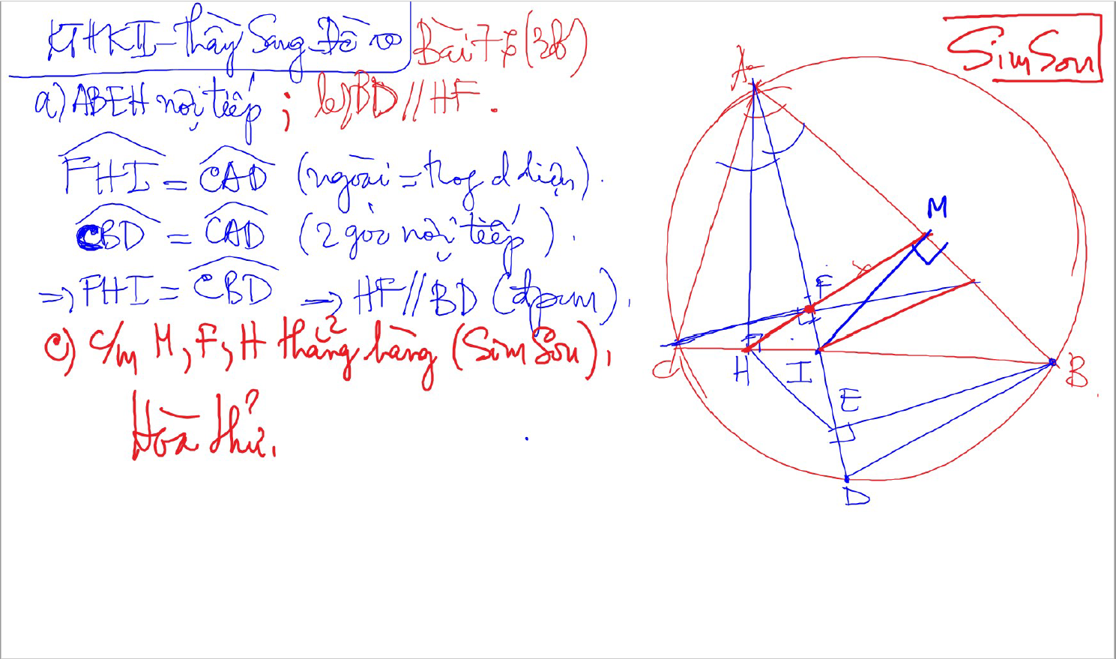
SIMSON

Slide 16
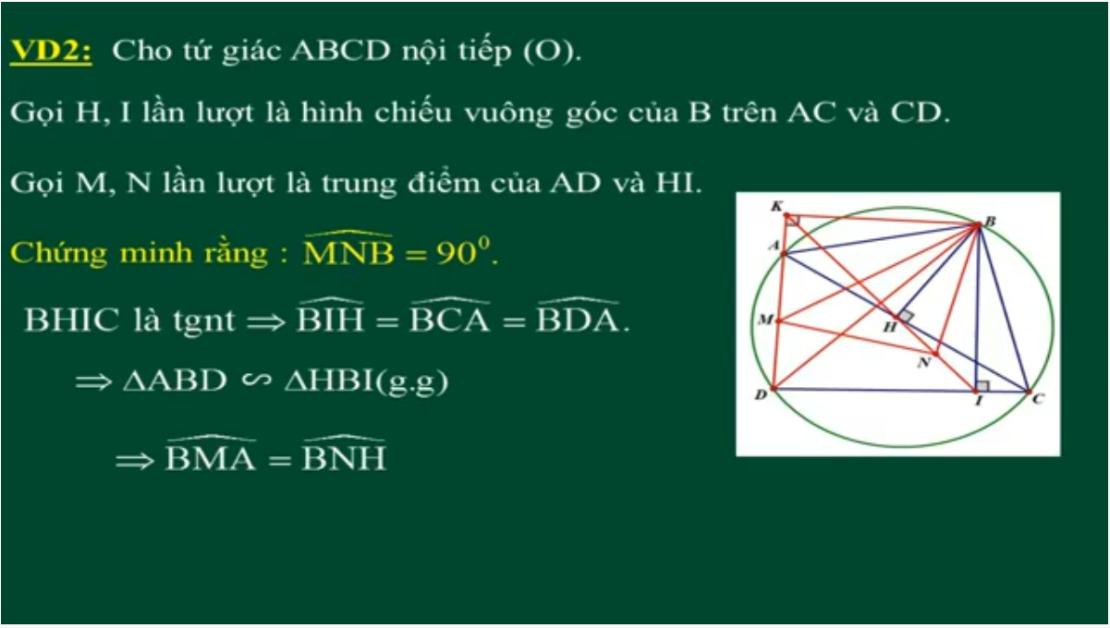
DUONG THANG SIMSON – Ap Dung

Slide 17
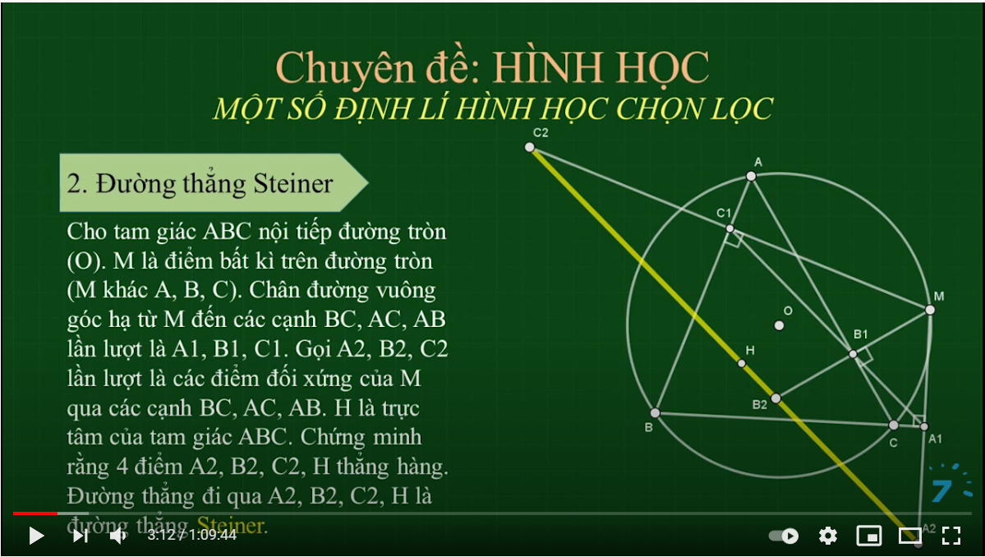
SIMSON

Slide 18
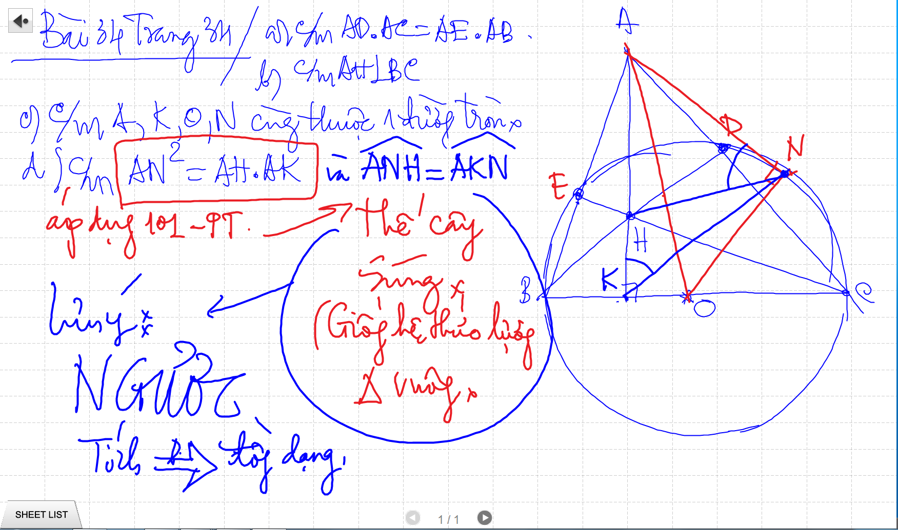

Slide 19
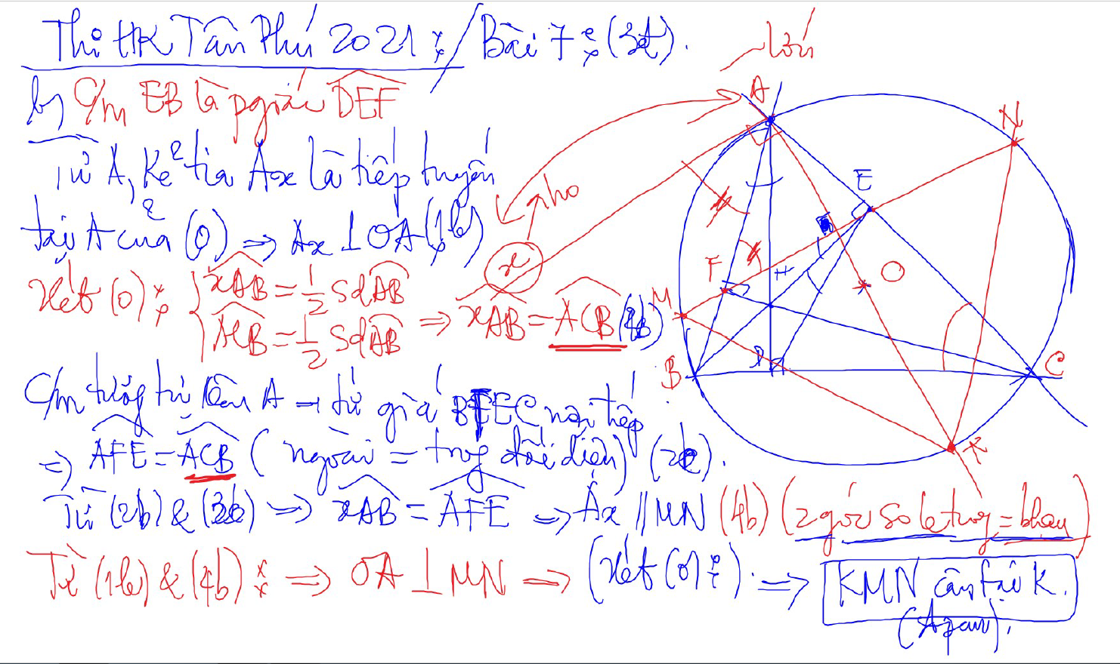
C/m tam giac dong dang truong hop 2

Slide 20
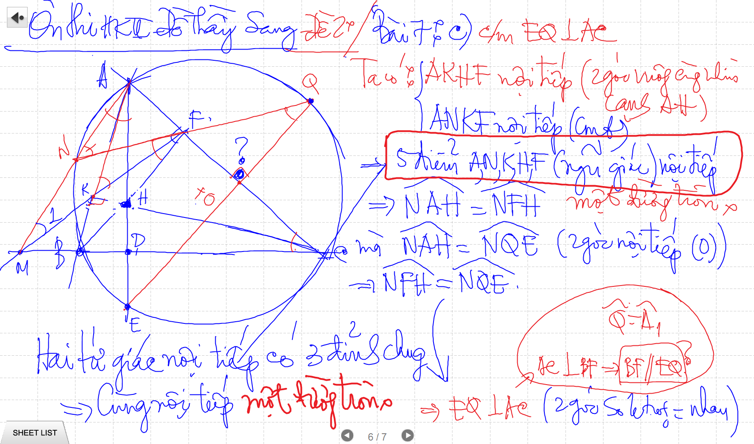

Slide 21
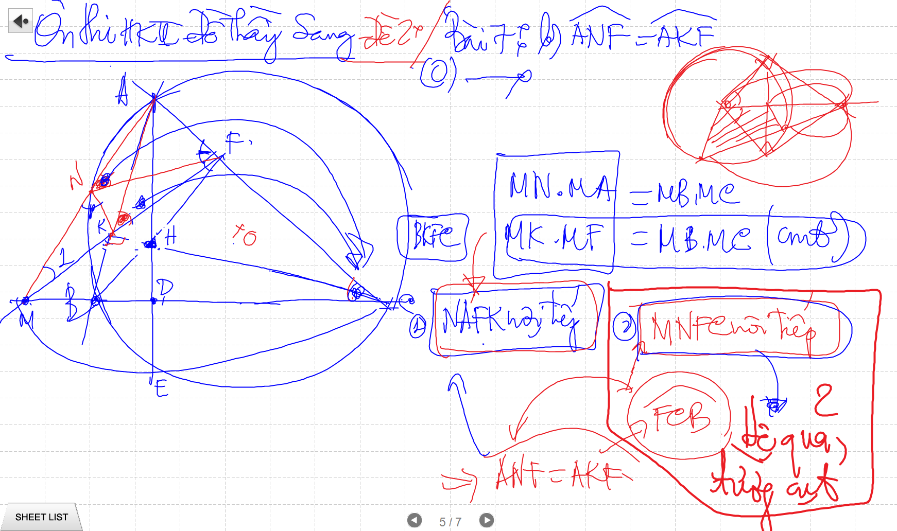
C/m tam giac dong dang truong hop 2

Slide 22
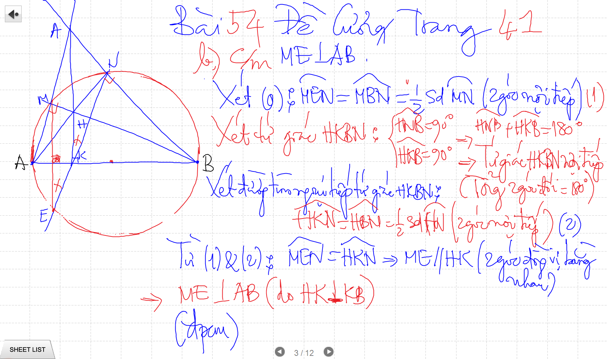

Slide 23
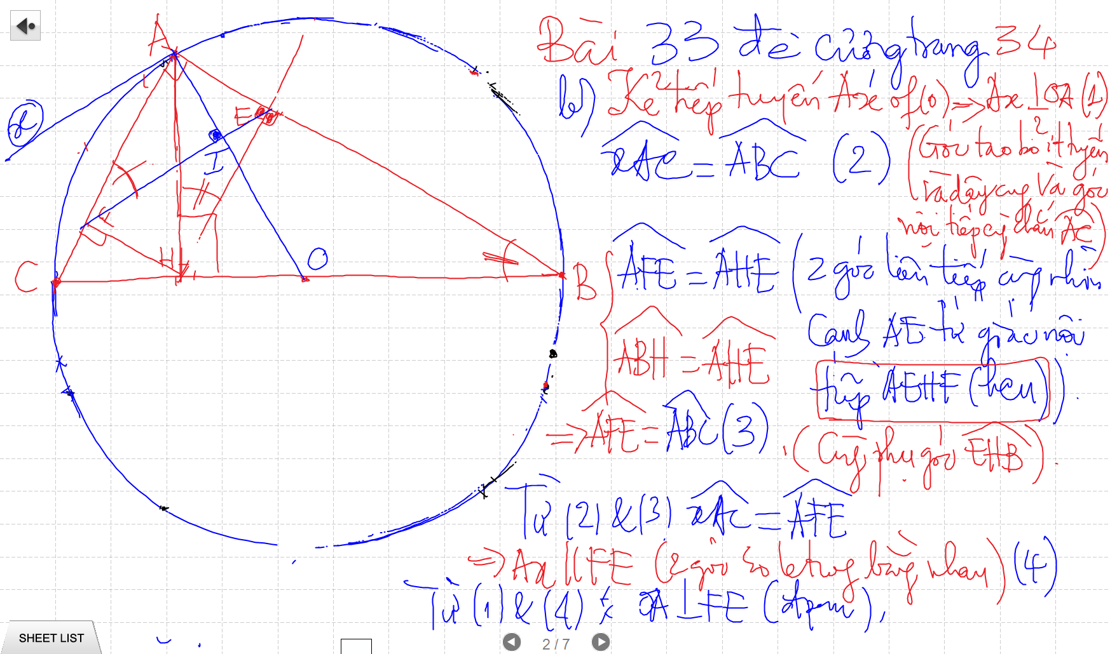
C/m tam giac dong dang truong hop 2

Slide 24
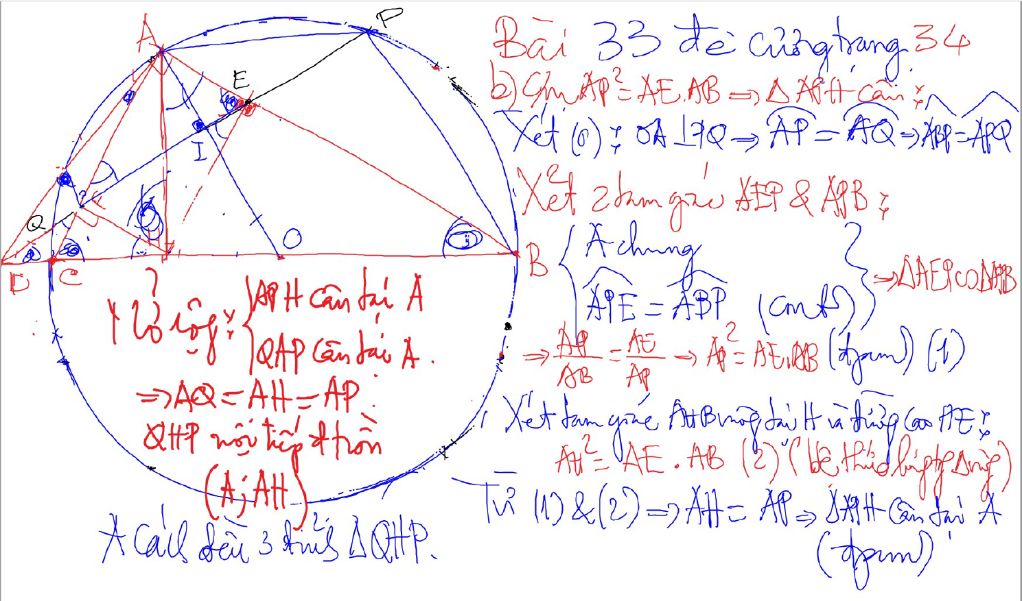
Bai 53 De Cuong – Kinh dien tam giac nhon 1 (xem trong thu muc Tu Giac Noi Tiep)

Slide 25
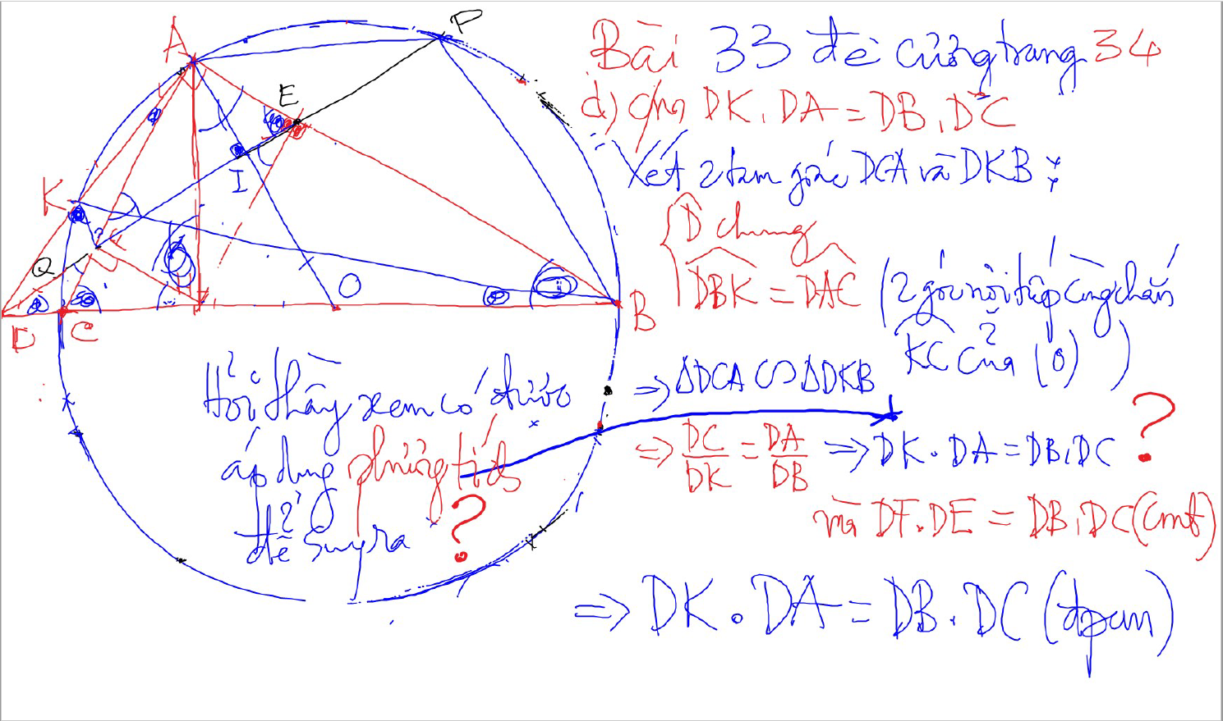
C/m tam giac dong dang truong hop 2

Slide 26
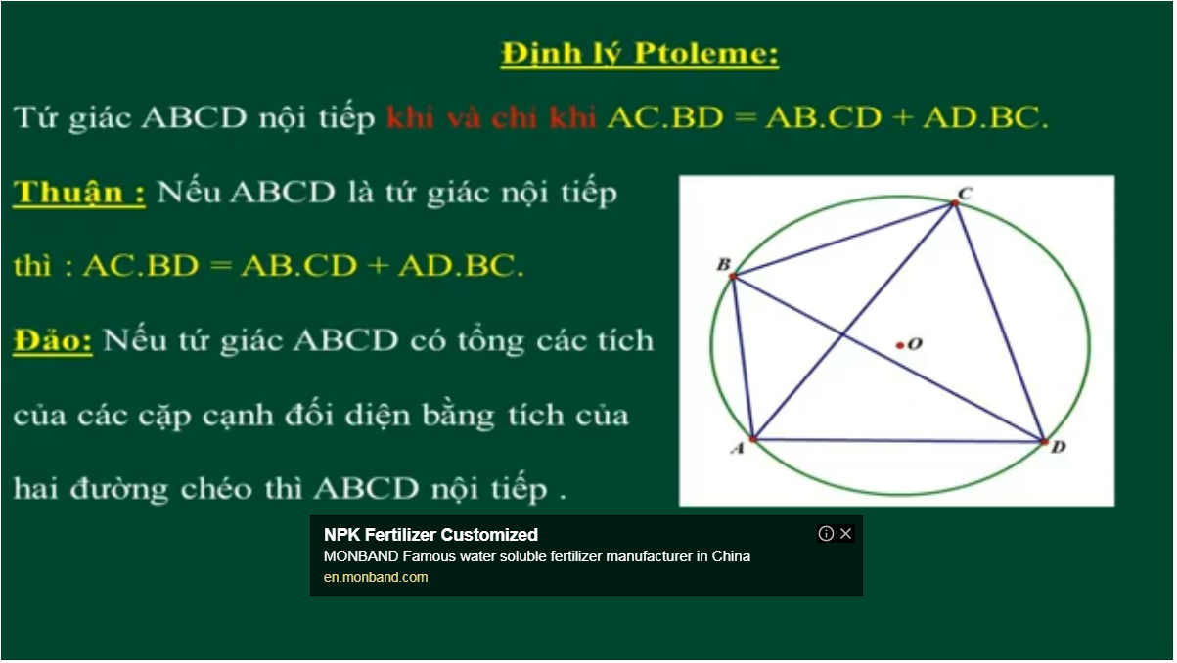
Bai 54 De Cuong – Kinh dien tam giac nhon 1 (xem trong thu muc Tu Giac Noi Tiep)

Slide 27
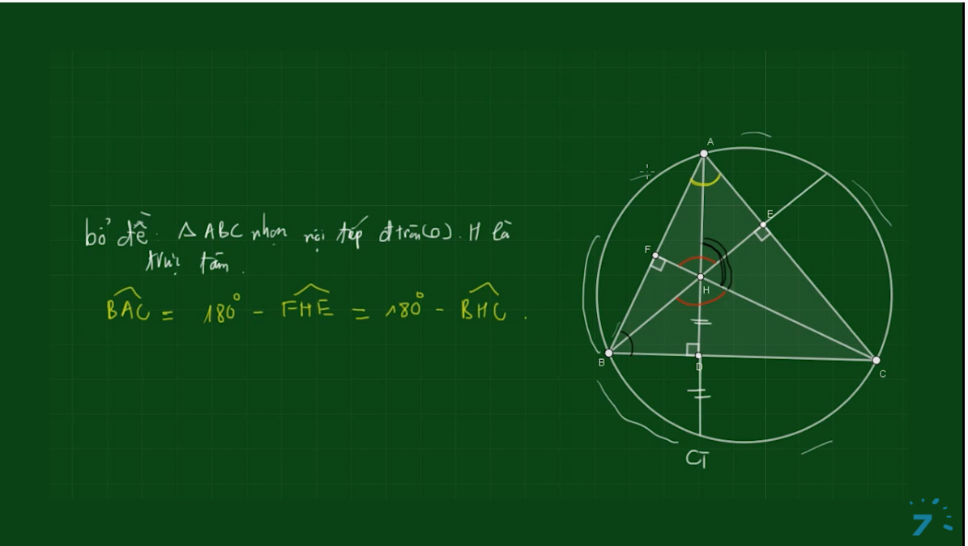
Bai 54 De Cuong – Kinh dien tam giac nhon 1 (xem trong thu muc Tu Giac Noi Tiep)

Slide 28
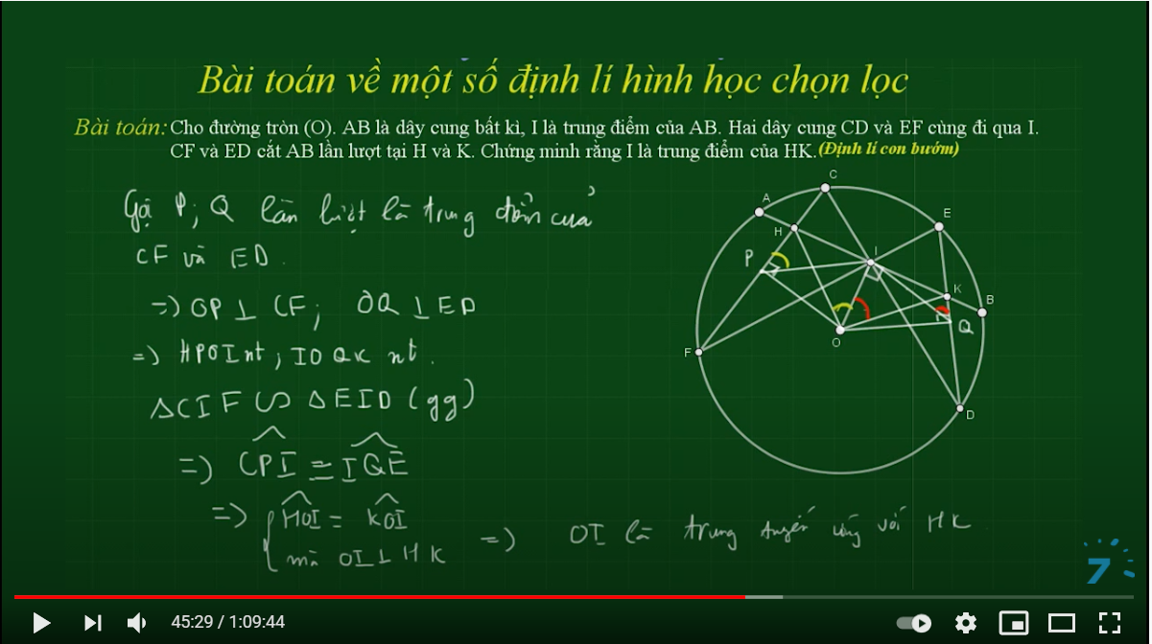

Slide 29
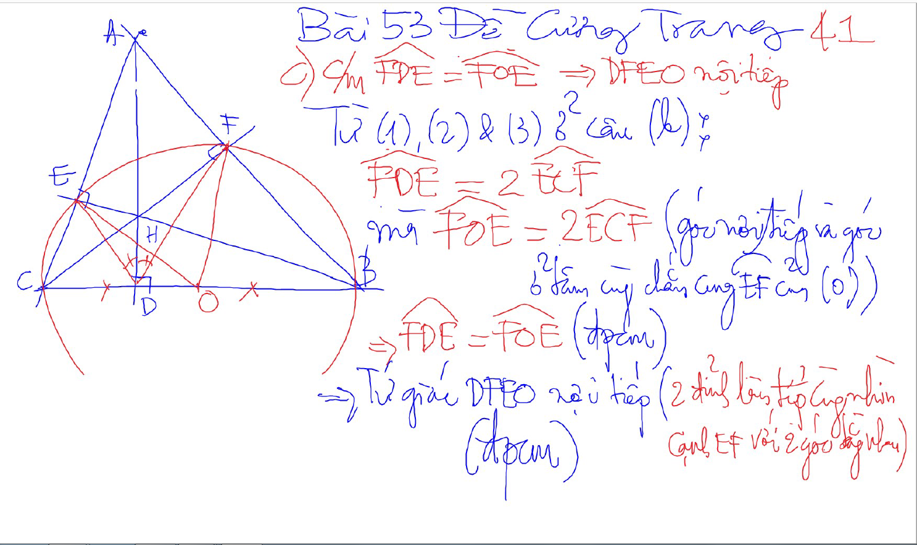
Bai 53 De Cuong – Kinh dien tam giac nhon 1 (xem trong thu muc Tu Giac Noi Tiep)

Slide 30
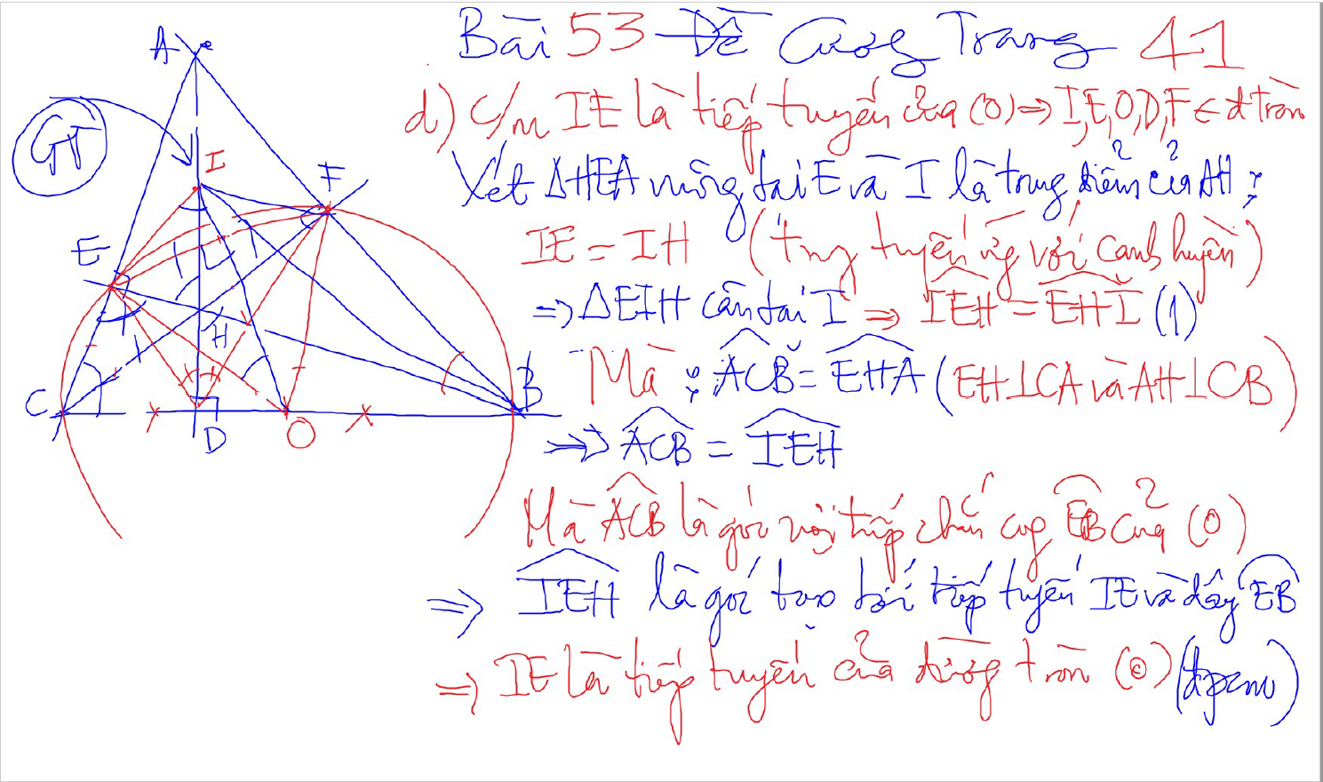
Bai 53 De Cuong – Kinh dien tam giac nhon 1 (xem trong thu muc Tu Giac Noi Tiep)

Slide 31
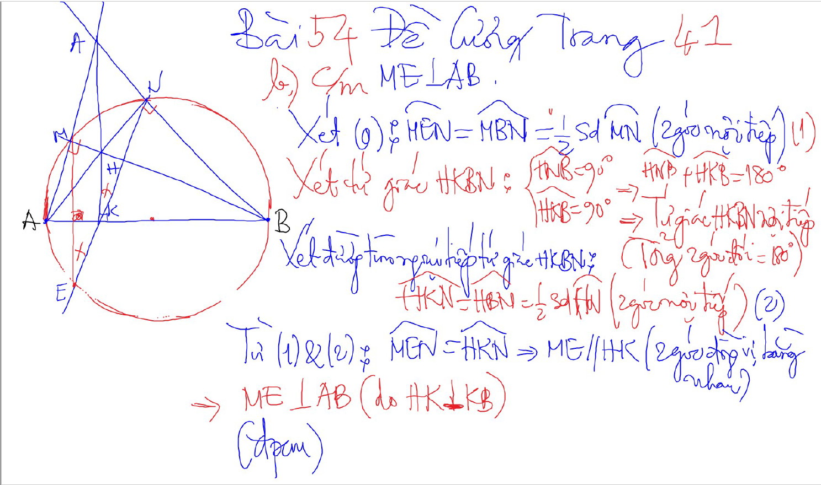
Bai 54 De Cuong – Kinh dien tam giac nhon 1 (xem trong thu muc Tu Giac Noi Tiep)

Slide 32
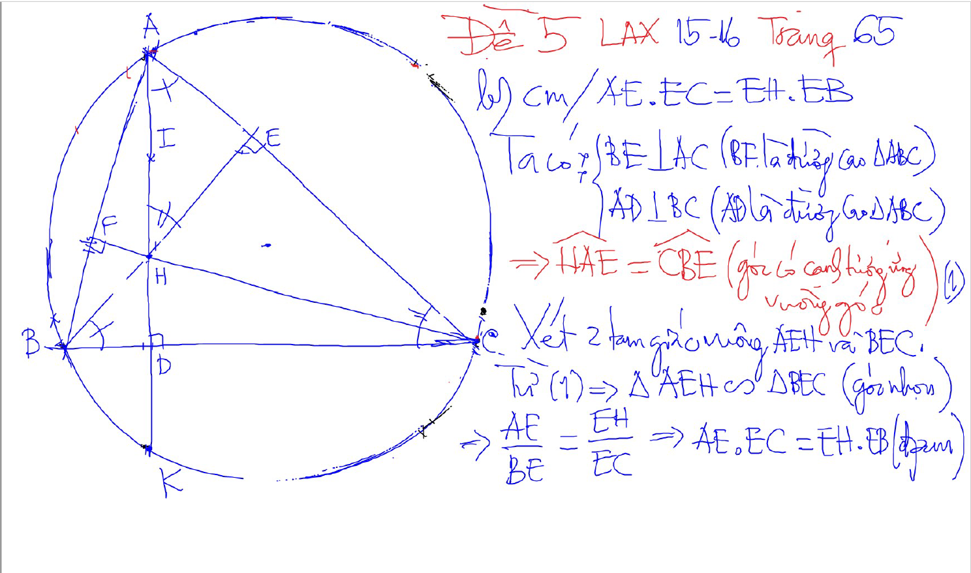
2 tam giac dong dang (truong hop 1)
2 goc bang nhau
1 goc nhon bang nhau

Slide 33
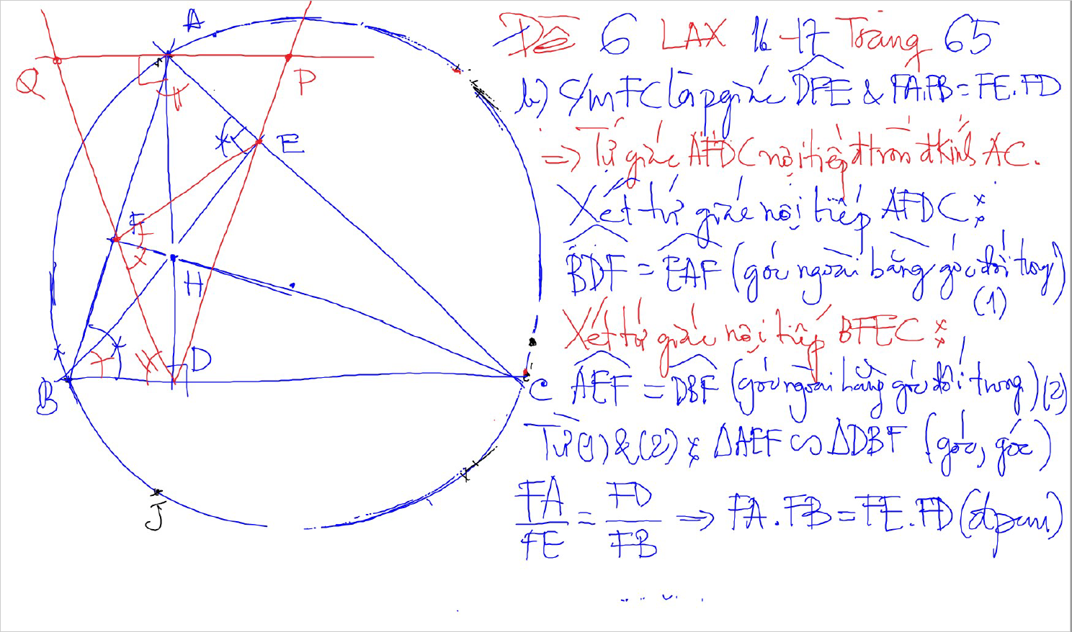
2 tam giac dong dang (truong hop 1)
2 goc bang nhau
1 goc nhon bang nhau

Slide 34
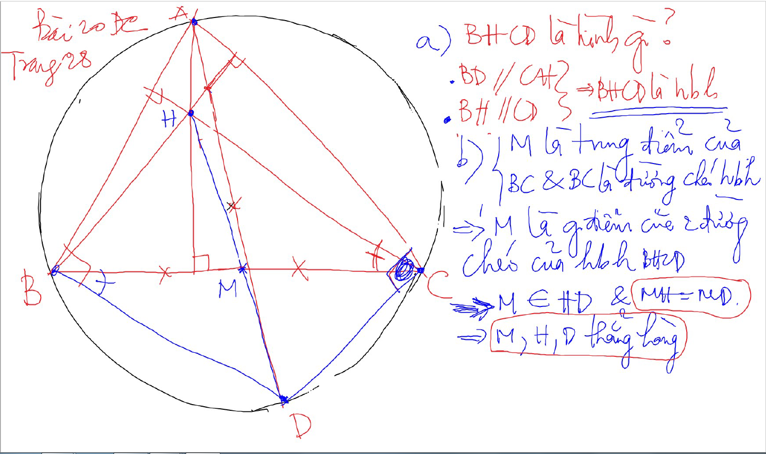

Slide 35
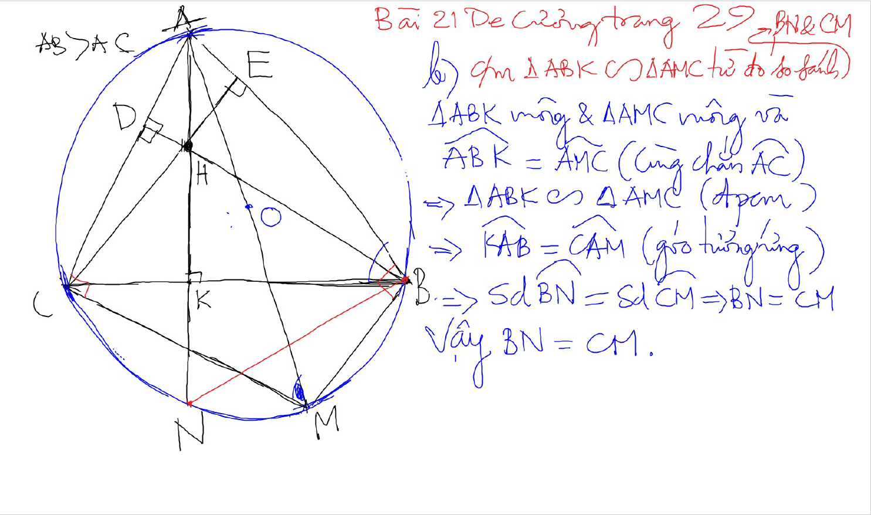

Slide 36
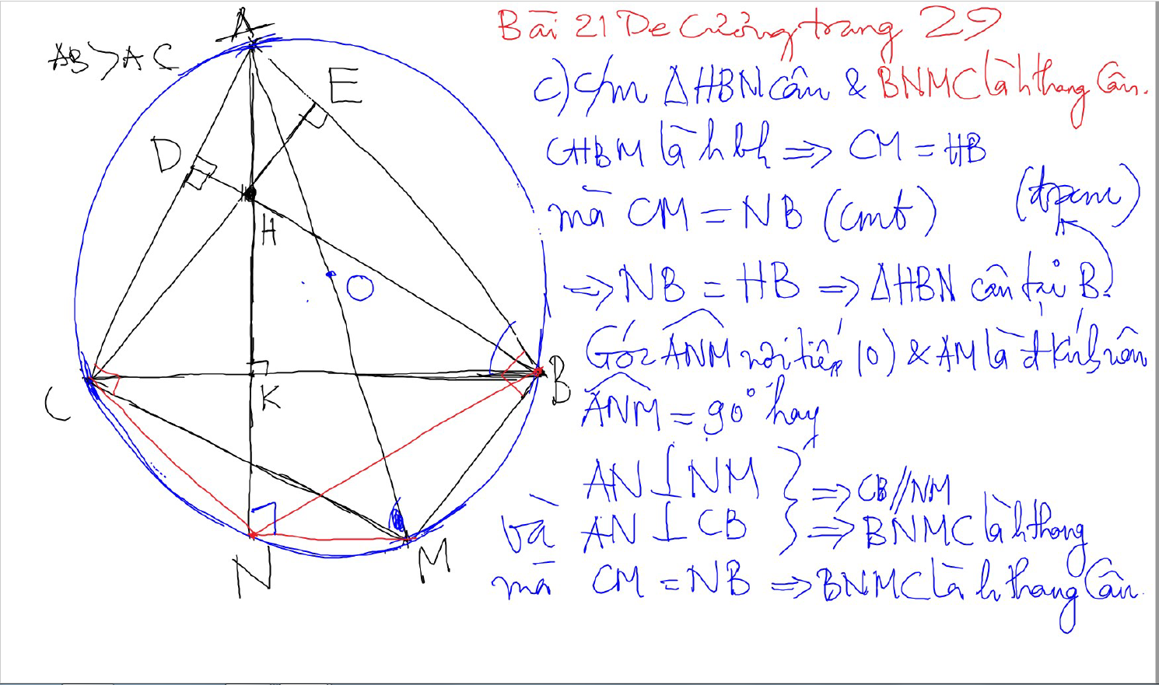

Slide 37
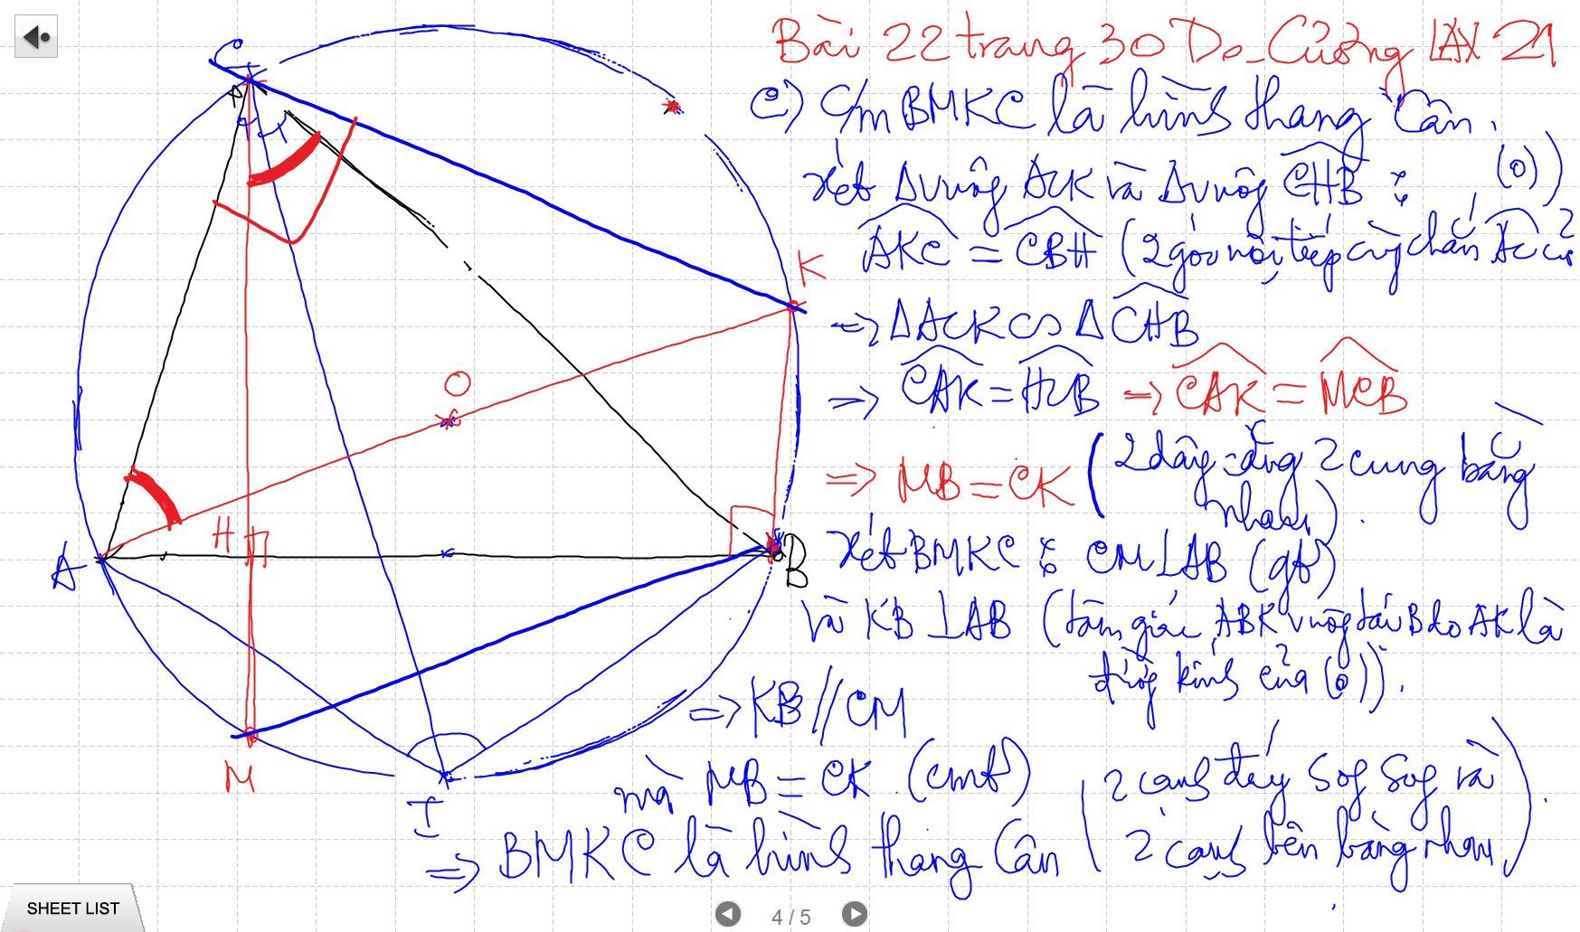

Slide 38
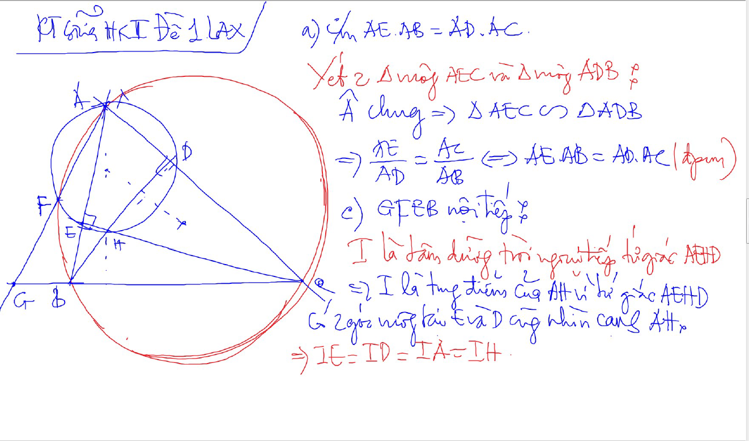

Slide 39
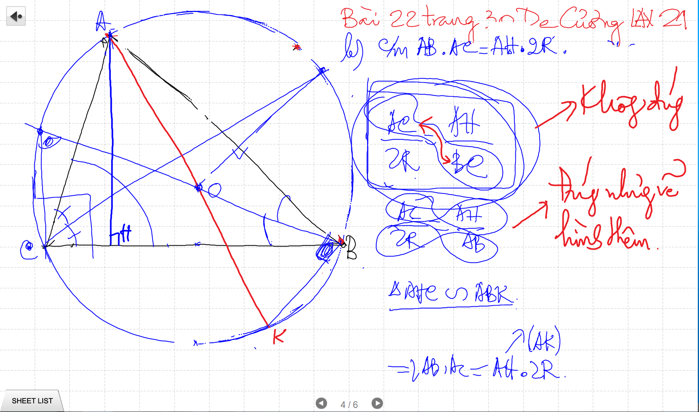

Slide 40
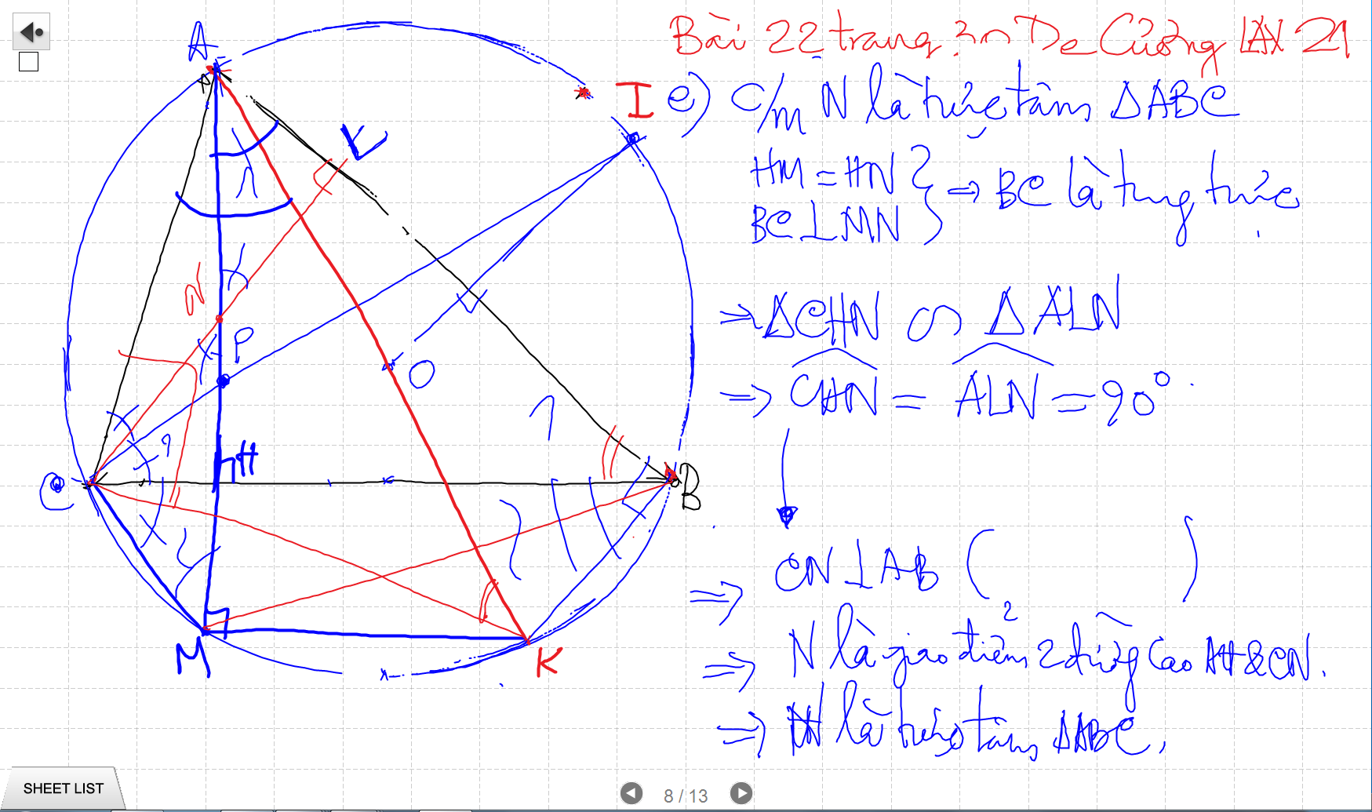

Slide 41
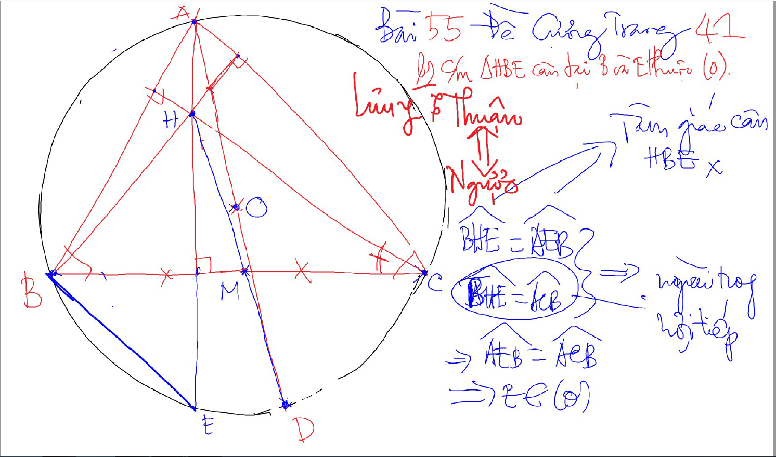

Slide 42
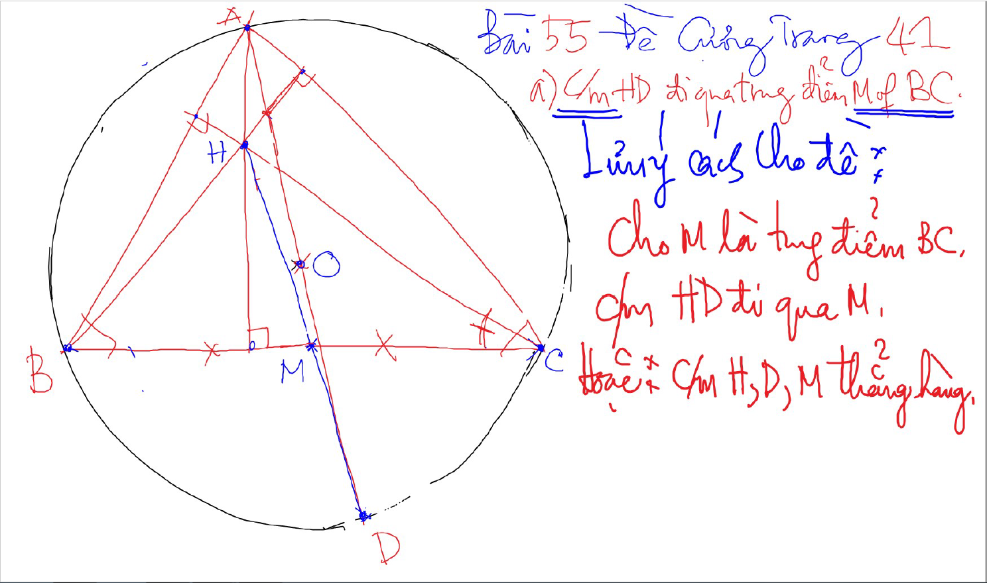

Slide 43
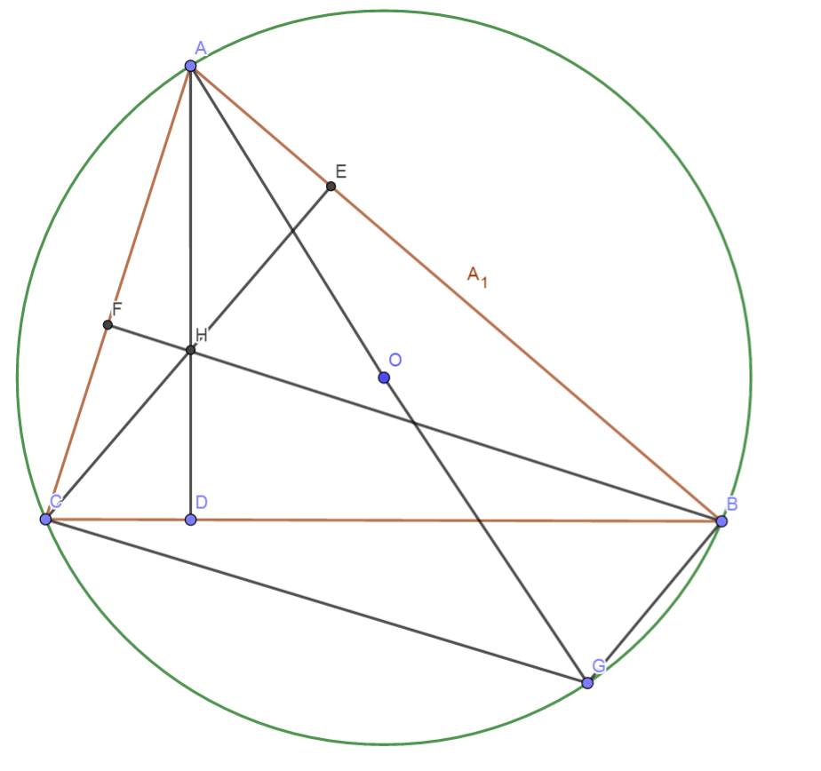
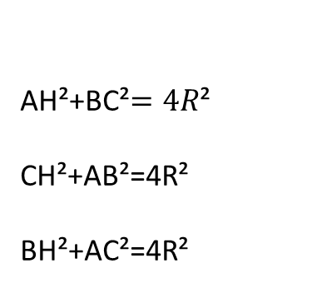
Quan he giua canh day va khoang cach den truc tam
AH²+BC²$=4R$²
CH²+AB²=4R²
BH²+AC²=4R²

Slide 44
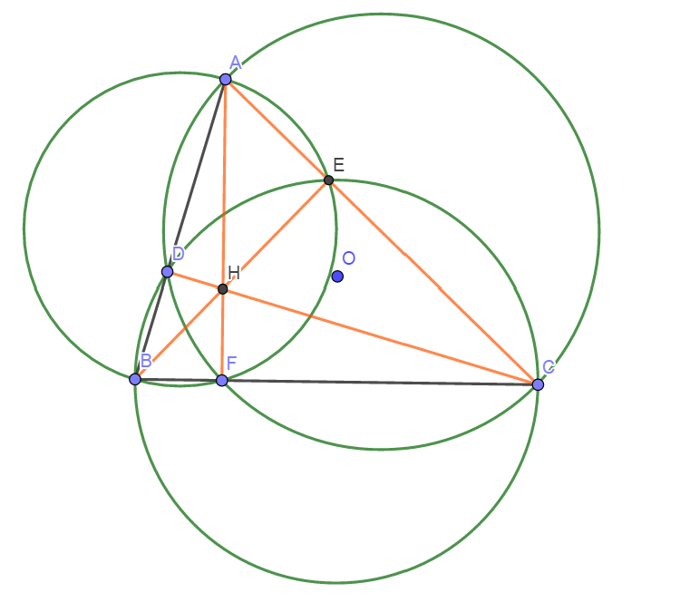
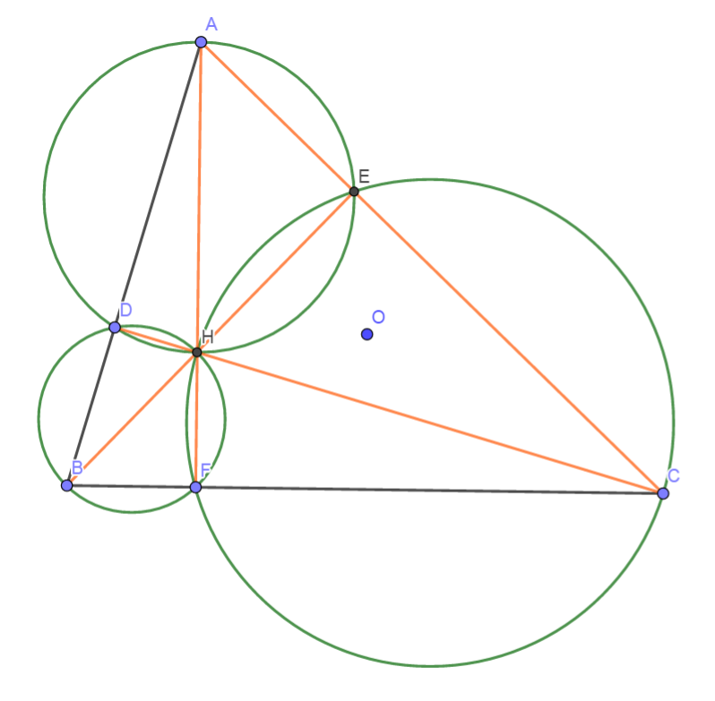
Truc Tam: 6 tu giac noi tiep

Slide 45
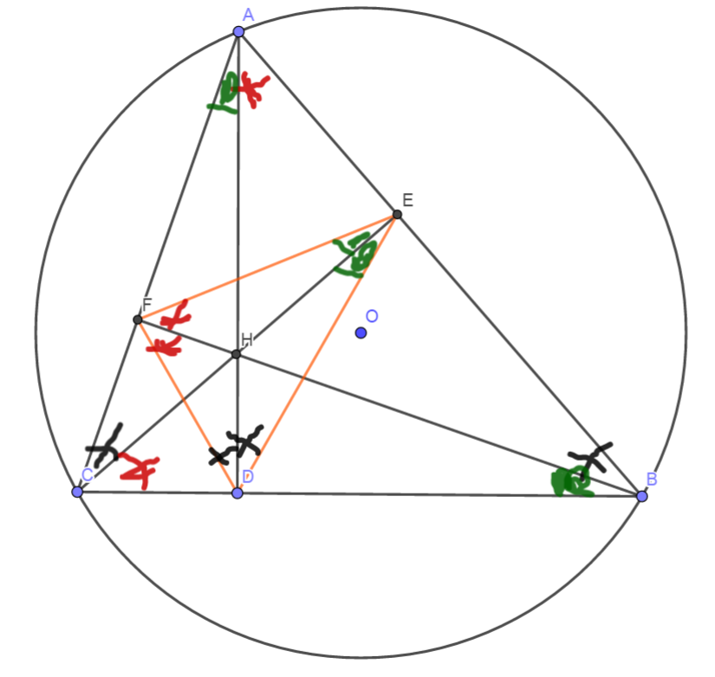
Truc tam: Tinh chat chan 3 duong cao
Chan 3 duong cao tao thanh tam giac DEF
3 duong cao cua tam giac ABC cung la 3 duong phan giac cua tam giac chan duong cao (DEF)
3 tam giac nho o 3 dinh (3 cai banh u) dong dang voi tam giac lon

Slide 46
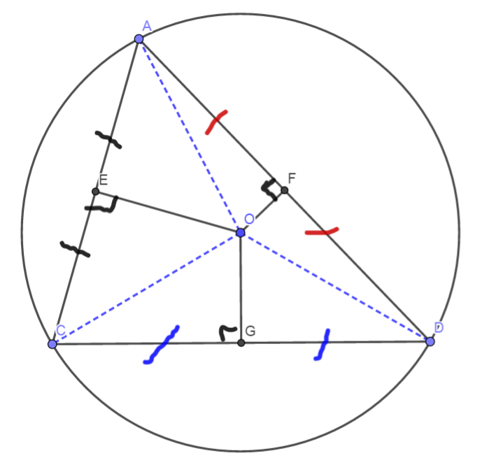
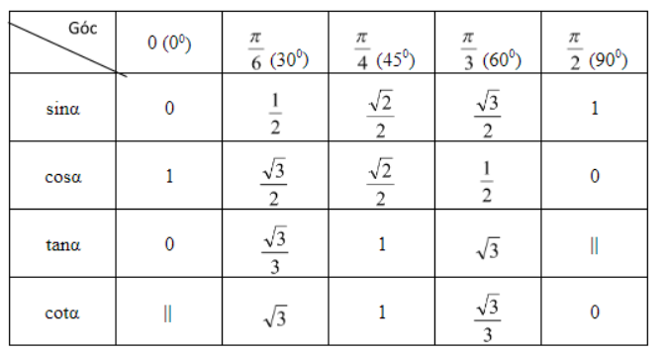
3 duong trung truc dong qui, la tam cua duong tron ngoai tiep tam giac
Giao diem cua 3 duong phan giac la tam duong trong noi tiep tam giac

Slide 47
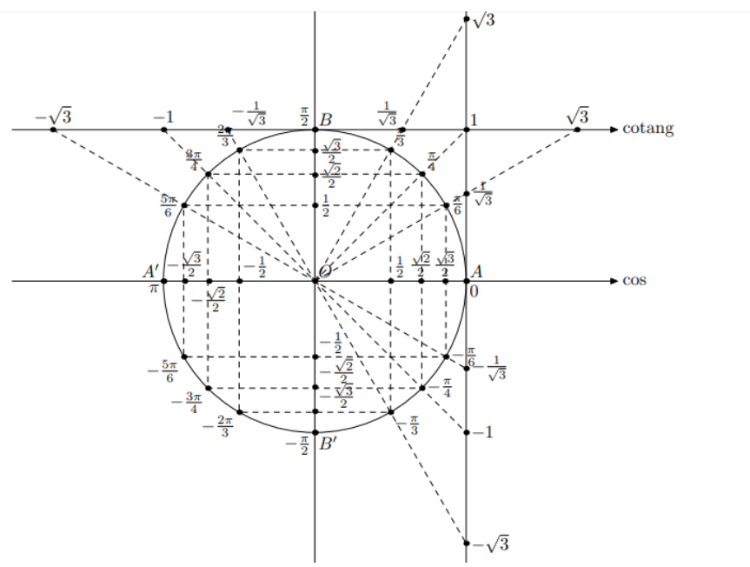

Slide 48
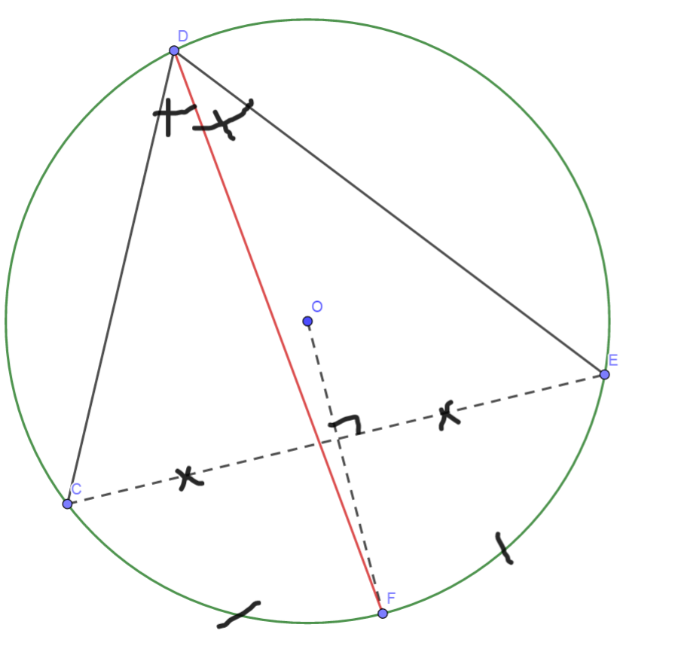
Cach ve duong phan giac cua goc noi tiep

Slide 49

Cach ve duong phan giac cua goc noi tiep

Slide 50

Cach ve duong phan giac cua goc noi tiep

Slide 51

Cach ve duong phan giac cua goc noi tiep

Slide 52

Cach ve duong phan giac cua goc noi tiep

Slide 53

C/m tam giac dong dang truong hop 2

